Slide 1


Cloud for AI
Course 11: Cloud Platforms
Filotas Theodosiou

Slide 2
Before we start!
A quick reminder!
The content of this course will not be included in the exam!
It is designed just to give you an idea how to work with Cloud Platforms

Slide 3
What are we going to talk about today

Slide 4
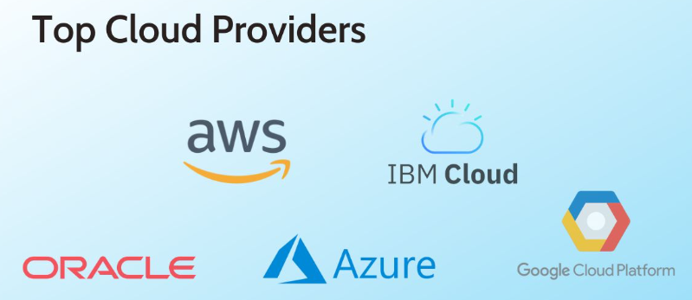
Cloud Platforms
Notes:
Todays course is about cloud platforms.
Why are they preferred, how to utilize them and things to consider
As you can see these are some of the biggest players in the cloud world
(Talk them one by one)

Slide 5
Before we start!
Attention!
Please, please be careful when trying one of these platforms.
Be very cautious as your monthly bill can skyrock really fast.
Leaving any digital prints or doing any actions costs some €€.
Notes:
Before starting I want to make this as clear as possible.

Slide 6
Overview
Basic cloud components
IT Infrastructures
Applications
APIs
Practical examples
Prebuild APIs
Your own models
Reference: The lecture is based on the “Digital Transformation Using AI/ML with Google Cloud Specialization” on Coursera (link)
Notes:
Ok, this is a quick overview of what we are going to consider.

Slide 7
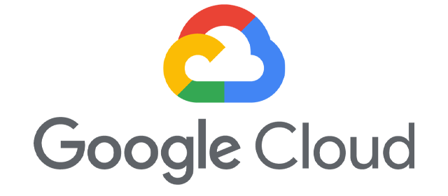
Google Cloud
Why Google Cloud over AWS and Azure:
User-Friendly Interface
Strong AI and ML Capabilities
Commitment to Open Source
Cost-Effective
Extensive documentation
Beginner’s Friendly
Notes:
Allright. So for this course I have selected google-cloud as the cloud platform to work on.
The main reason is that it is much more beginner friendly than Azure or AWS.
It also have a very nice user-friendly interface.
It does not have as many features as AWS but it has more than you will need as beginners!

Slide 8
IT Infrastructures
Notes:
Ok, lets begin by talking about IT Infrastructures and how these are being modernized

Slide 9
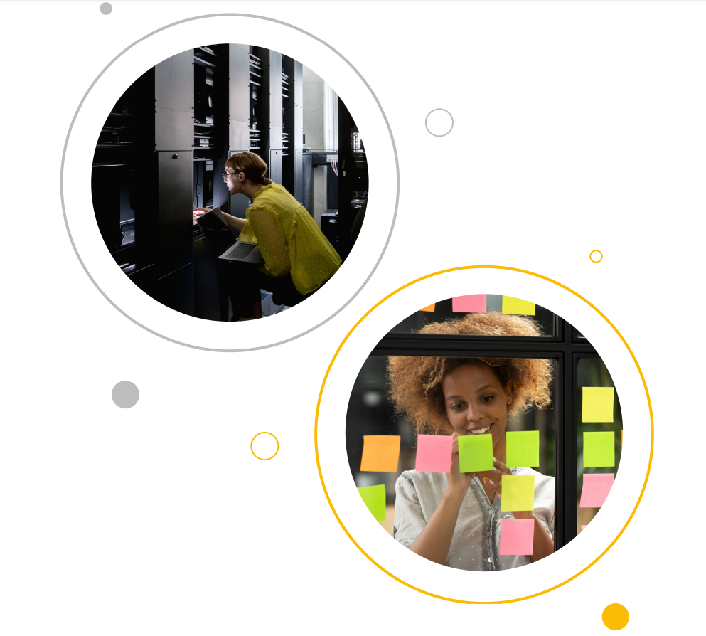
A New Business Model
Scaling applications used to be a competitive advantage for big companies
Now its the norm for successful enterprises!
What does that mean to IT Resources:
Big organizations do not want to spend budget on IT resources
They want to create high value products
Small organizations and startups have great ideas but no expertise in IT
Notes:
Some years ago, in the so called era of “Big Data” scaling an application to include more users used to be an advantage
Now its the norm. As soon as a company grows, scaling is more extremely important to keep users satisfied
However this creates limitations for scaling the hardware as we saw in the last lecture
Organizations do not want to spend by money for IT resources. \
In addition, smaller companies or start-ups do not have the expertise to design IT solutions.

Slide 10
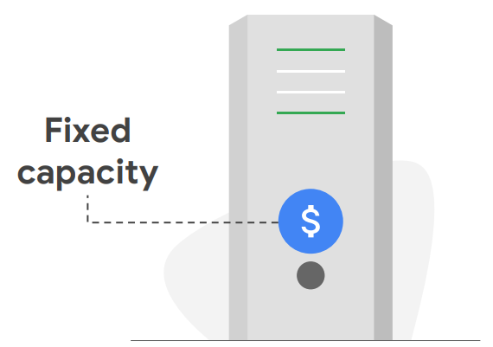
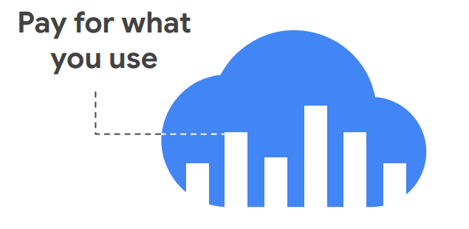
A New Business Model
Enterprises have financial benefits from Cloud technologies
The new IT strategy:
From buying fixed capacity
To paying only for what they use
Notes:
This is where cloud comes into the game.
There has been a new IT paradigm over the past years.
Companies, instead of buying big server rooms with predifenied capacities
They started investing in only what they use at every time. Not more not less.
This has provided greeted financial benefits for such organzations.

Slide 11
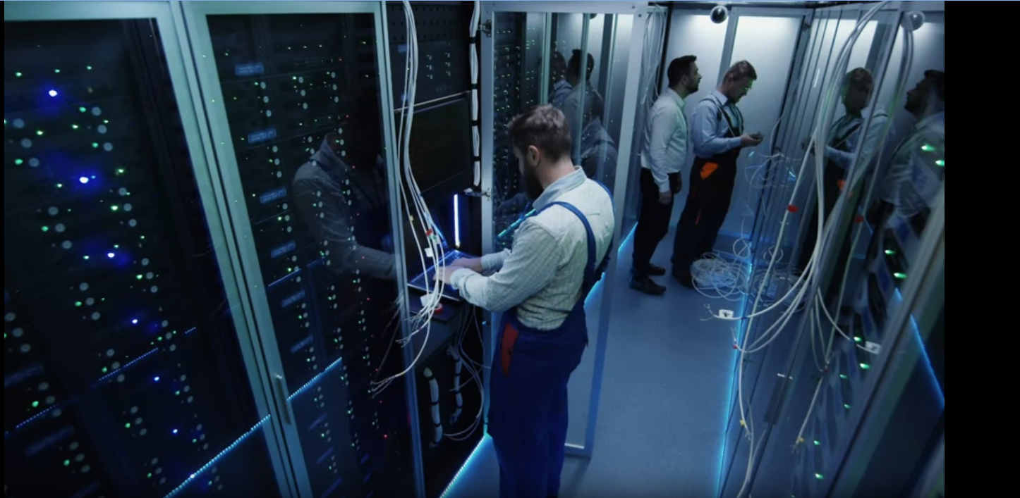
Before the Cloud
Employes within a Tech Company:
Store data
Connect with each other
As the company grows:
They need more compute
They build Servers & Data Center
The Problem with Data Centers:
Expenses
How much more compute?
Cooling systems, physical security
Maintenance
Notes:
So lets review what things looked before the cloud era.
Companies used to store their data in their own infrastructures
They had these big rooms with computers that are connected to each other
When the companies reached its limit and wanted to expand they need to buy new computers
So at some point they started building data centers and big servers
However, as we said, this created lots of problems.
How much compute to add? How to estimate?
Together with extra centers, more expenses are added (maintenance, security, cooling systems)

Slide 12
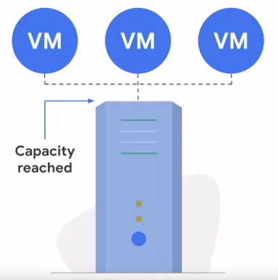
Solutions!
Virtual Machines!
They optimize the use of resources
Share CPUs
Share Storage
Share Networking resources
Have multiple applications at the same server
Notes:
So as we said, the opted for Virtual machines to optimize the use of resources
They had multiple instances on the same computer that shared CPUs storage and network
This way the could run multiple applications in the same server

Slide 13
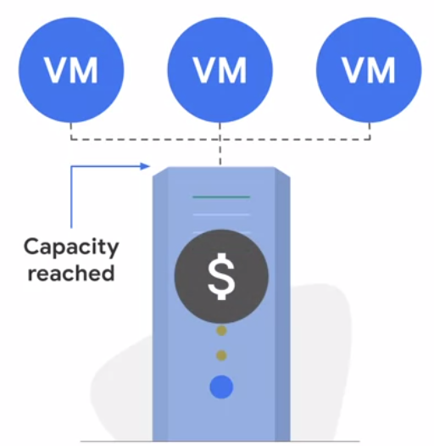
A Solution
Virtual Machines!
They optimize the use of resources
Share CPUs
Share Storage
Share Networking resources
Have multiple applications at the same server
The problem?
There is still a cap to the physical capacity!
They have to invest for Data Centers up front
Notes:
However, as mentioned, VMs carry their back of problems.
First there still a limit on how much they can scale. After a point they would need extra resources again.
Second, they still have to make a big invesemtns to some data center up front.

Slide 14
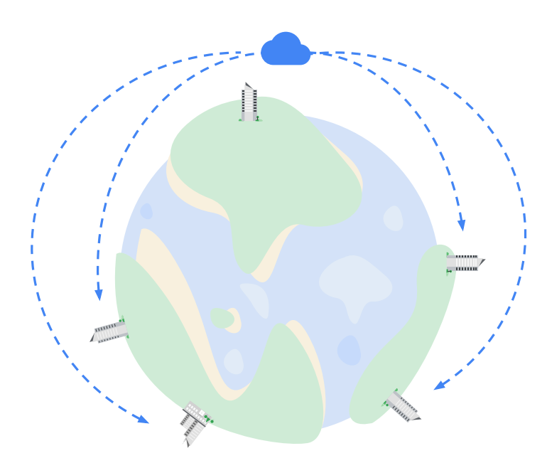
Other Solutions
In summary:
Growing companies need to deliver products & customers regionally & globally.
They need to scale quickly!
Maintaining data centers is expensive
Notes:
So whats the situation? We have big companies that have huge demand and want to expand across the globe.
They want to scale quickly and they know that data centers costs a lot of money to build and maintain.

Slide 15
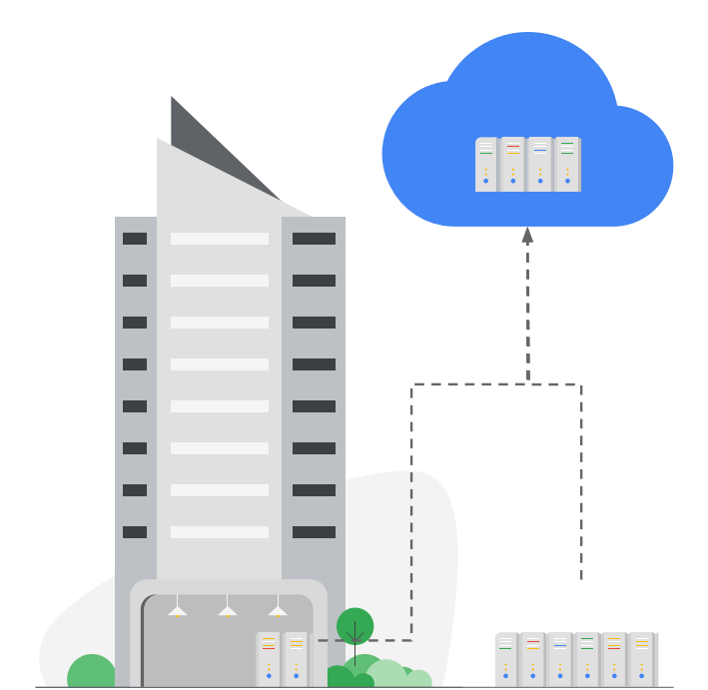
Other Solutions
In summary:
Growing companies need to deliver products & customers regiaonaly & globally.
They need to scale quickly!
Maintaining data centers is expensive
What do they do:
They move (some or all) their infrastructure from physical data centers to virtualized data centers in the cloud
Notes:
So what they do?
They move their infrastructures from their physical data centers in the cloud!

Slide 16
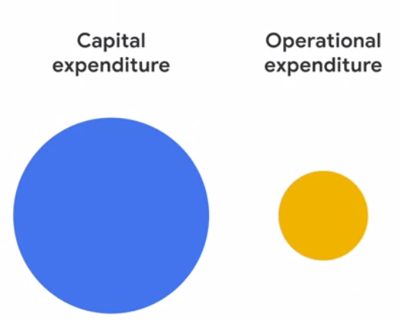
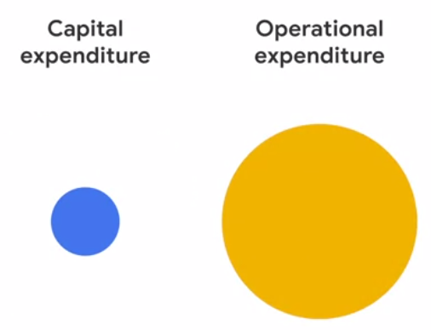
What Moving to Cloud Means:
From spending more for IT
To spending more for Applications
Notes:
this is how google describes the costs associated with IT on cloud and locally.
I dont agree 100% but this is the general idea.
Leveraging cloud solutions allows you to spend most of your budget on operational issues and not on capital which was the case with local IT infrastructures.
That means more money for your application and less worries on your head about failing hardware

Slide 17
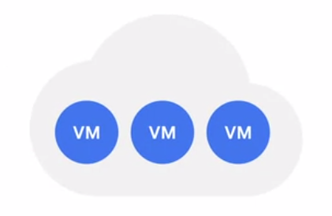
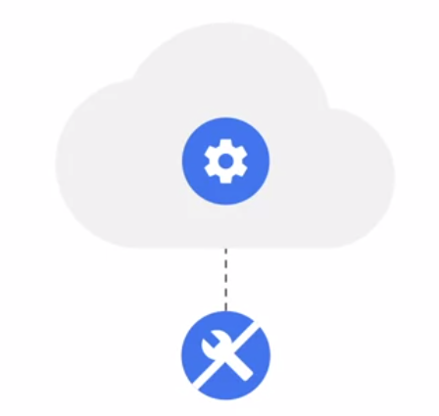
Cloud Services
Pay as you need infrastructures
2. Additional Services (eg ML tools)
3. No Maintenance costs
Notes:
These are the properties of the cloud and what do they offer
You pay whatever you need. As we said, you can pick your preferences, your limits or let it scale uatomaticmaly. They support all options. You only pay for whatever you ned.Carefull, the problem is to be certain on what you need as costs can increase super fast
They offer additional services like integrated ML solutions, data engineering pipelines, dashboards etc
You dont have to worry about failing hardware. They take care of it. You only focus on your application.

Slide 18
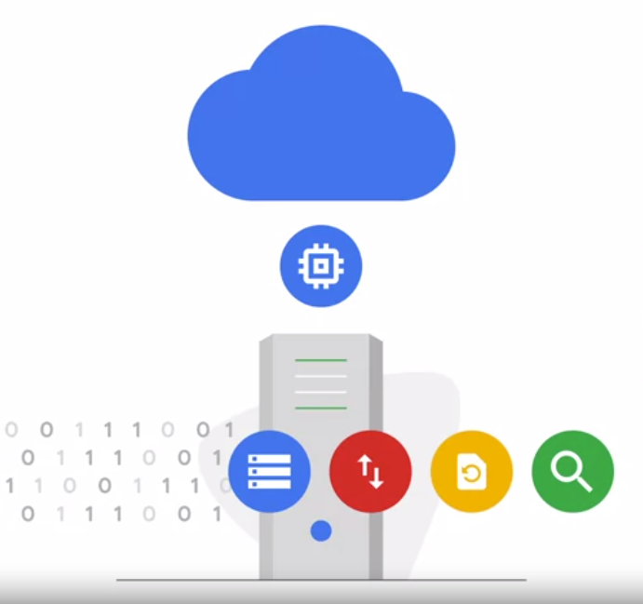
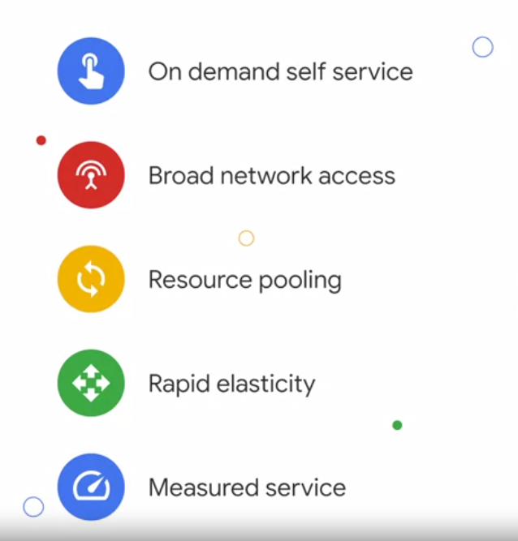
Benefits of Cloud Computing
Compute
Store
Retrieve
Compare
Analyze
Notes:
And based on these services, these are the benefits they offer.
You can easily pick any services you want
You can access your services anywhere you are on the planet
You can easily pick any GPU, CPU and scale it accordingly
You can scale up and down given the demand
And on the right you have the use cases of cloud
(just read them)

Slide 19
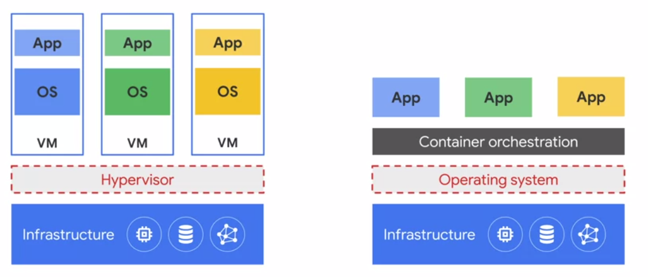
A quick reminder
Virtual Machines vs Containers
Notes:
Just remind them here what is going on

Slide 20
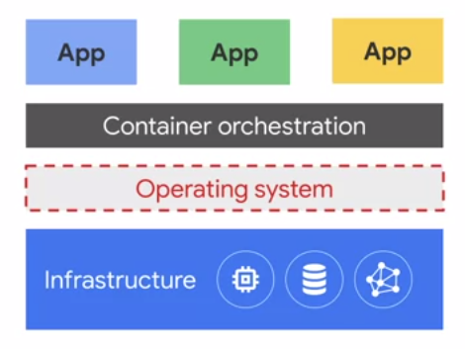
Cloud & Containers
Benefits of Containers:
Hold exactly what's needed for an application
Start faster
Use less memory
Make more predictable environments
Notes:
We talked about the benefits of containerization and why prefer them
These benefits are alos transferred to cloud services too!
They carry all the requirements and dependencies
They start much faster because they have much less memory
And finally they can be used to recreate environments as they were originaly

Slide 21
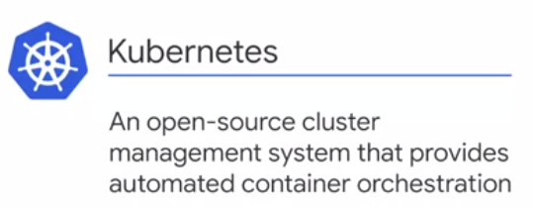
Cloud & Containers
Benefits of Containers:
Hold exactly what's needed for an application
Start faster
Use less memory
Make more predictable environments
Companies might have thousands of containers
Keeping them secure is hard!
Oversight
Management
Notes:
An issue for companies is when they have a very big number of containers
Maintaining and oversighting becomes tricky
This is where kubernetes is used.
Its developed by google and its an application that does clusters management of your containers. It takes care that everything works accordigly

Slide 22
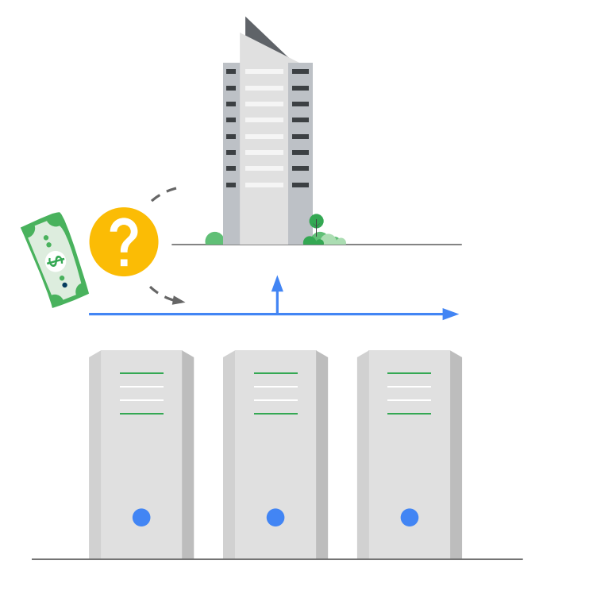
Serverless Computing
Another benefit of the Cloud
Resources (eg computer power) are automatically provisioned behind the scenes as needed
Businesses do not pay for compute power unless they are actually running a query or application
Business provide code for whatever they want and the cloud provider does everything else
Notes:
Ok, finally the last benefit is serverless computing. In my opinion this is the best way to use the cloud
So the idea is that you keep your data somewhere stored. If you want to make an action you only pay for that action the time you make it.
That mens you dont pay for computer per month but everytime you make a batch-prediction
There are options that allow you to make predictions on a date that you have picked
Remember the example with batch inference on a super market. You make the predictions on a Sunday night and you have them ready on /Monnday morning.

Slide 23
Some Cloud Services
Compute Engine
A computing service that lets you create and run Virtual Machines on Google Infrastructure.
Kubernetes
A managed environment for deploying, managing and scaling containerized applications
Google App Engine
Platform-as-a-Service for developing and hosting web applications
Cloud Run
A platform for building applications in your favourite programming language without worrying for infrastructure management
Cloud Functions
A serverless execution environment for connecting cloud services. Runs different code applications with zero server management
Notes:
These are some of the many functons that google offers.
(read them)
depending on your case and what you want to achieve you can pick what suits you

Slide 24
Applications
Notes:
OK good. Any questions? Now that we talked about infrastructures lets move to applications and why you want to consider deploying them on cloud

Slide 25
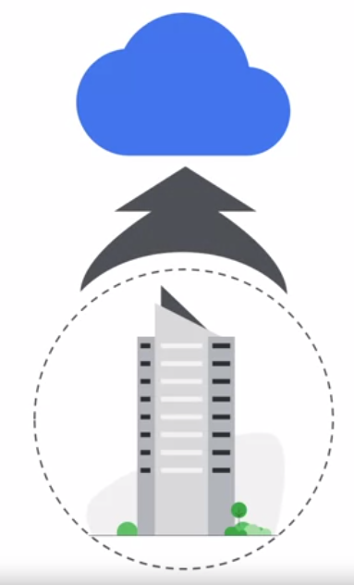
Why Applications on Cloud
Sometimes developing applications on-premises can slow business down due to the time-consuming and IT requirements
Cloud Technology enables business to develop and manage applications in a more agile and responsive manner
Move applications from prototype to production much faster
Notes:
Ok lets start by deployment.
If you develop an application in-house and you ran it in-house you might lose a lot of time when you set up IT infrastucutres. Remember your time is valuable
If you want to move your application fast from prototype to production you need to consider cloud platforms. You saw the example with streamlit, how easy it was to deploy the application. The same is true for the cloud but on bigger scales
It makes deployment much faster and easier

Slide 26
Different ways to migrate to Cloud
According to Google Cloud there are 3 major ways to move an application to the Cloud
Move First and Change
Just take your application and move it to the Cloud
Change before moving
Re-architect the application first to be cloud-ready
Create-to-Replace
Build a new application to replace your on-premise one
Notes:
There are 3 ways, according to Google to move t a cloud platform.
Just take your app and upload it to the cloud. This is fast but might not run or might have additional costs
Next you adjust your application and then you migrate. This is a bit more time consuming but ensure good compactibility and performance
Third develop a new application from scratch to replace your old on. This is the most time consuming but most optimal in terms of costs and performance

Slide 27
Challenges for new Applications
Before building a new application:
Define Scope & Feasibility
Identify Data Sources & Build Features
Estimate Capacity
Define a Technical Architecture
Consider Integration with the System
Allocate Resources
Notes:
Now if we move a bit back to what we learnt from the ML circle, its very important before building an application to have everything pre-defined.
Read them

Slide 28
Challenges for new Applications
Before building a new application:
Define Scope & Feasibility
Identify Data Sources & Build Features
Estimate Capacity
Define a Technical Architecture
Consider Integration with the System
Allocate Resources
Sometimes, this is more time-consuming than actually building the application
Notes:
It should be noted here that most of the times actually coming up with a good project plan is much more time-consuming that building the actual application.
Thats why its a very important step!

Slide 29
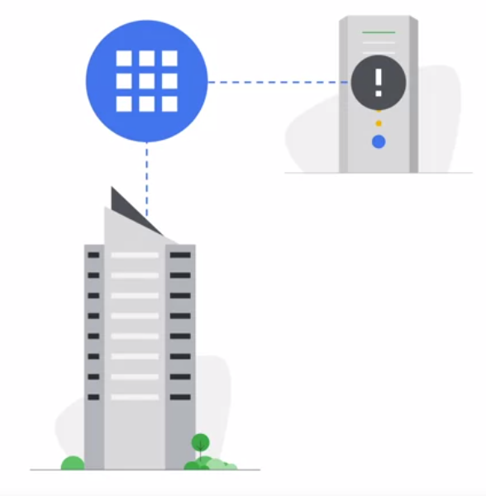
Innovate Faster!
With Cloud Computing:
Focus on application development over managing infrastructure
Automatically scale resources if there is a peak
Deploy in Minutes
Move from prototype to production in minutes
Notes:
To summarize the part for the applications.
Cloud offers flexibility. You focus on developing the application and not building and maintaining data centers
You can scale and pick your thresholds and adjust them at any time
You can also very easily take and deploy your application without having to optimize for IT!!
Its a good solutions for all company sizes depending on what the company wants to achieve!!

Slide 30
APIs
Notes:
Now lets remember what an API and how it is extremely important for cloud operations

Slide 31
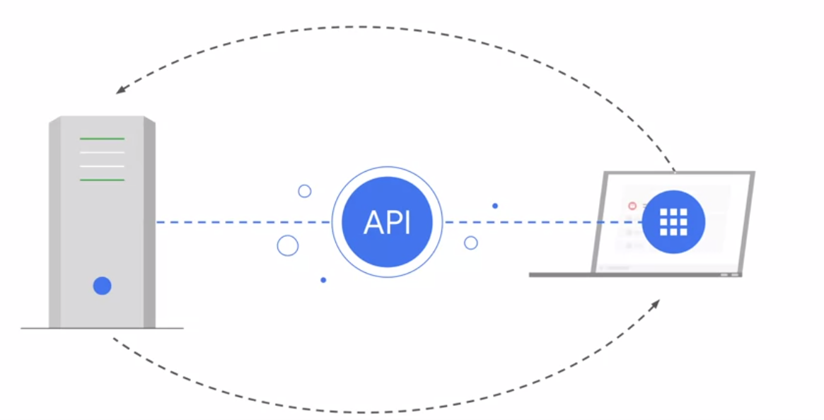
A quick reminder
An API is a piece of software that connected different applications and enables information to flow between systems.
Notes:
In short, an API is what connects different systems and allows the flow of information. We have talked about it in our previous lectures.
Very important for the AI world

Slide 32
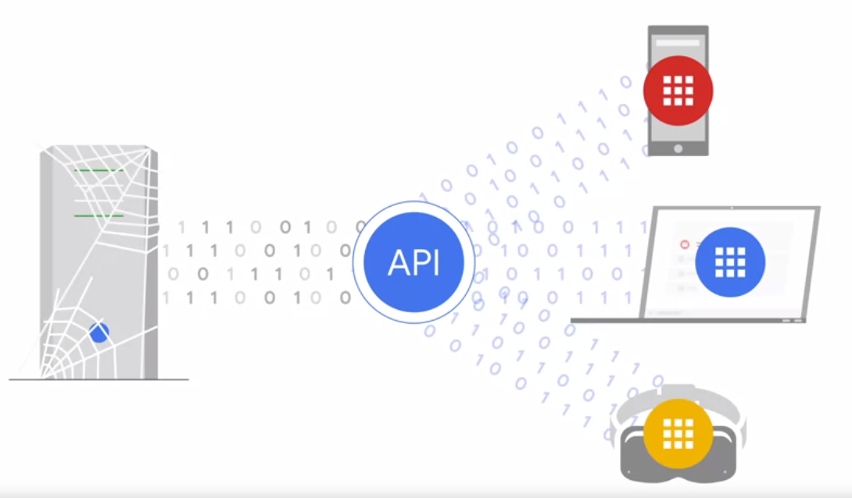
A quick reminder
They enable integration between systems so businesses can unlock value and create new services
Notes:
So in the cloud world, an API allows for devices to connect to the central data center (say of google) and manage their applications.
Its a necessitiy in todays world!

Slide 33
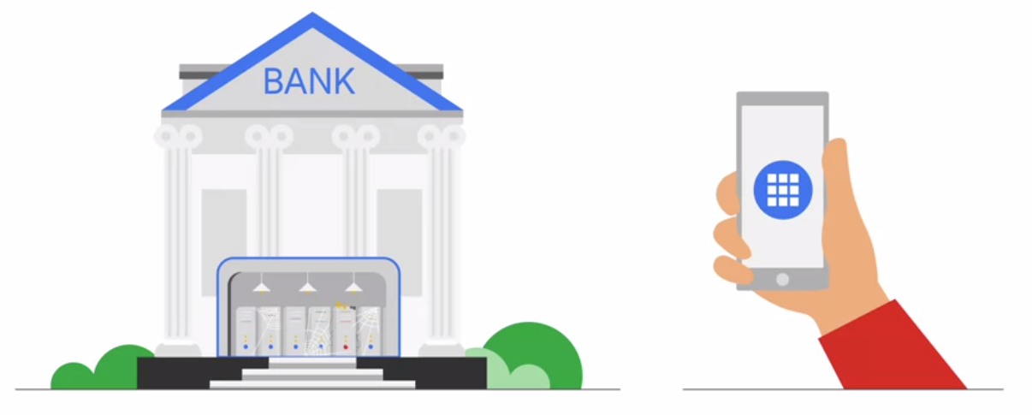
The need for APIs
A bank holds the records of all bank accounts on their Data Centers
Notes:
Say for example you have a bank that holds all the bank details, transactions, etc

Slide 34
The need for APIs
A bank holds the records of all bank accounts on their Data Centers
Nowadays users make payments through their phones so they require immediate access to their data
Notes:
And you want to access your internet banking to make a transactions.
You want immediate access to the banks details.
This was not possible 4-5 years ago!

Slide 35
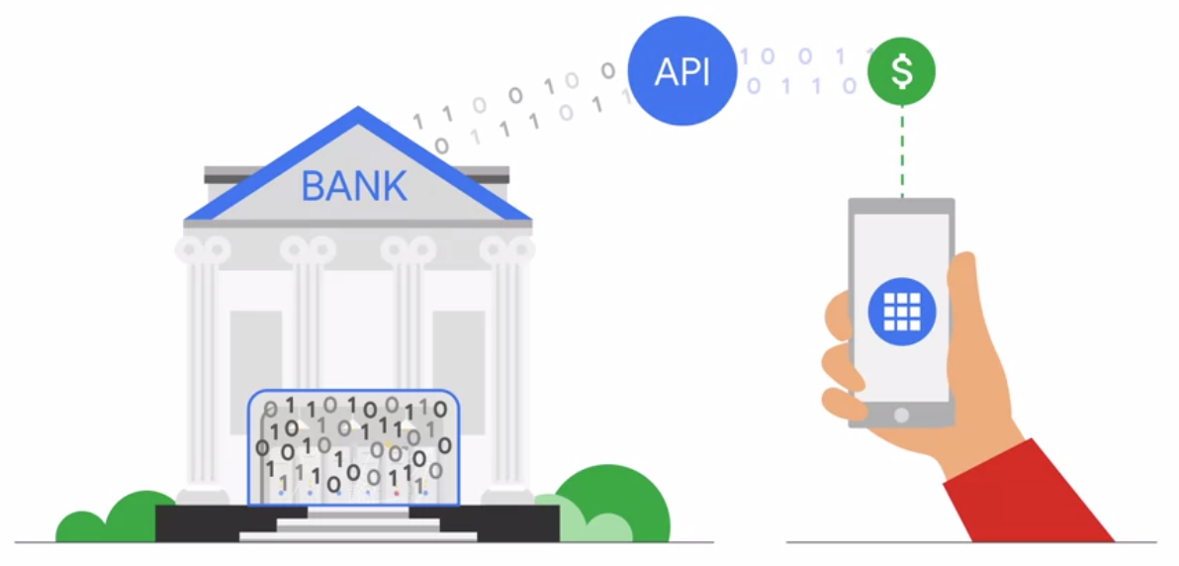
The need for APIs
A bank holds the records of all bank accounts on their Data Centers
Nowadays users make payments through their phones so they require immediate access to their data
To connect the database to the end-user application the bank uses an API to allow information flow.
Notes:
but witha well-established API you can easily access the banks database in seconds and make any actions you want!
This is what happenes with cloud platforms too.
The rapid development of API unlocked the usage of cloud-platforms

Slide 36
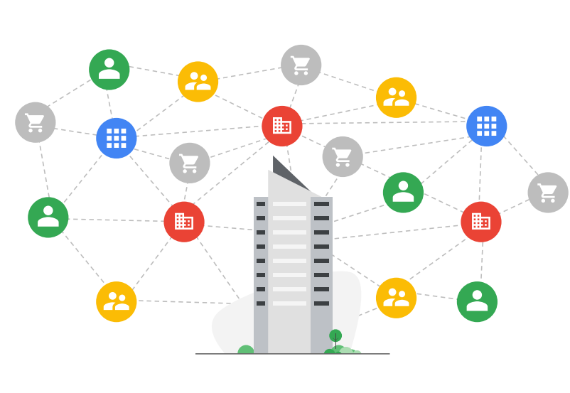
Modern Challenges
Its usual for companies to have an ecosystem of different APIs interconnected with users and services.
As the ecosystem grows, the time and effort to manage hundreds of APIs at scale becomes costly
Apigee:
A Google Cloud service for easy API management system.
Handles and scales APIs automaticaly
Notes:
As with any new technology there are some challenges when using multiple APIs for a cloud platform.
the most obvious is how you manage this ecosystem of API. Who is responsible for making sure everything works accordingly?
Cloud providers have services that handle APIs. However they should only be utilized when you have a truly big number of APIs
Otherwise it will complicated your tasks even more.

Slide 37
ML in the Cloud
Notes:
Allright! enough with general information. Lets do so ML in the cloud.

Slide 38
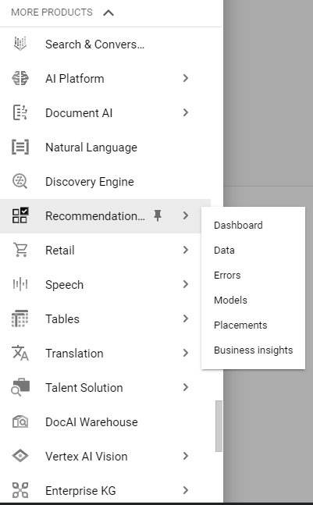
Cloud ML Services
Cloud Platforms offer plenty of pre-build services.
In short, you do not need to use any code.
Just upload your data and get predictions.
Examples:
NLP API
Vision API
Retail (Forecasting) API
Vision API
Speech API
etc
Notes:
Example from Google.
Most cloud platforms (google included) offers pretty of pre-build services to easily apply ML models with just a few clicks.
Some include pre-trained models where you can easily select what you want to achieve without having to code anything.
Just with a few clicks you take a model and throw it in your dataset. They also handle hyperparameter optimization and model selection if you want
Here are some examples!
(read them and explain what each does)

Slide 39
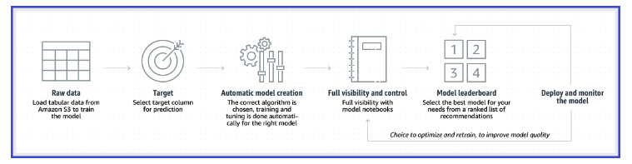
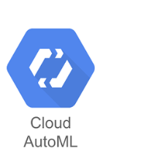
AutoML
With AutoML you can train ML models without ML expertise
How?
Upload your data (text, image, video speech) -> properly labeled
Select training/test splits
Click train (Automatic model/hyperparameter selection)
Review model metrics
Deploy your model
Notes:
And that takes us to a data scientists worst nightmare.
AutoML.
With automl one can simply give a task and the platform would handle the rest.
IT does automatimatc model selection and paramtero optimization based on your picked criteria and the size of your training set.
A very good solution for quick implementations. Also you will be impressed by how good these guys are!
They are a tough to bit benchmarks for an inexperienced data scientists.

Slide 40
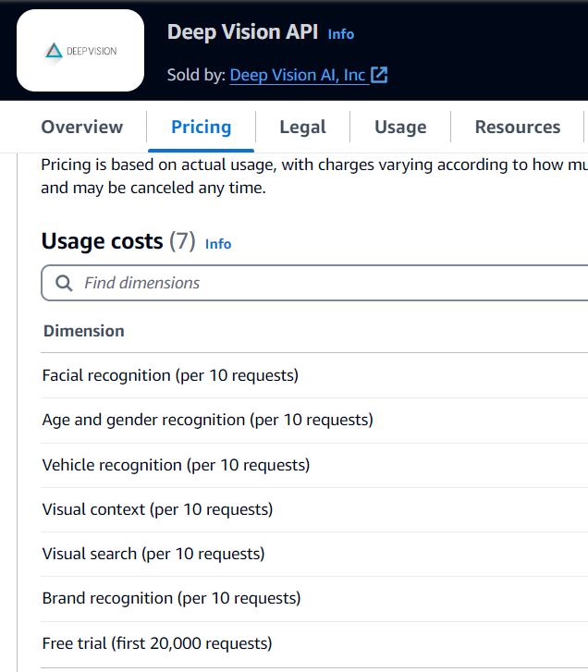
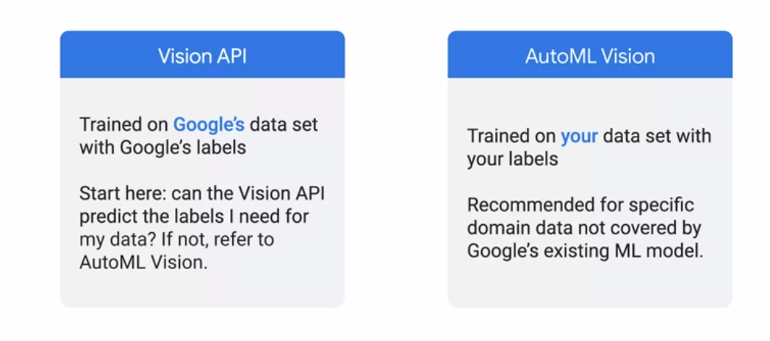
Two different APIs (for example on vision)
Notes:
That leads us to two different functionalities
Pretrained models from google trained on google datasets. PAy attention, some times the data used for training might not make sense for your application
In that case you go to AutoML. You provide your dataset and google handles model selection and training for you
So attention. One has pre-trainedm models and the other allows you to traine them on your task-specific data!

Slide 41
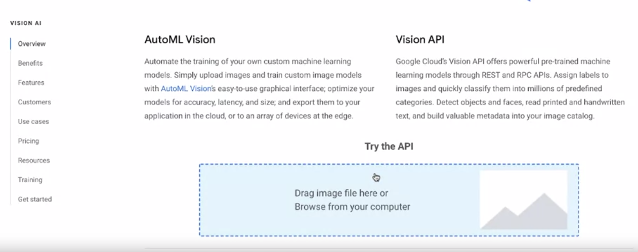
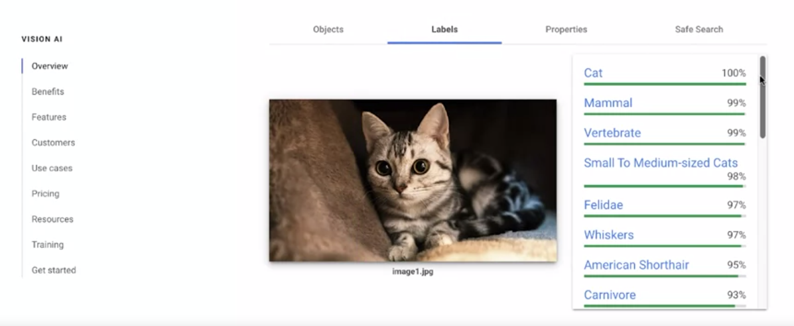
Vision API Example
Upload an image!
Get Results
(classification, object detection and more)
Notes:
This is how easy it is.
You go to Vision API for google, you upload an image and you get the result back.
A problem is that the model might not have the labels you want. Then you consider automl
Or training your own model

Slide 42
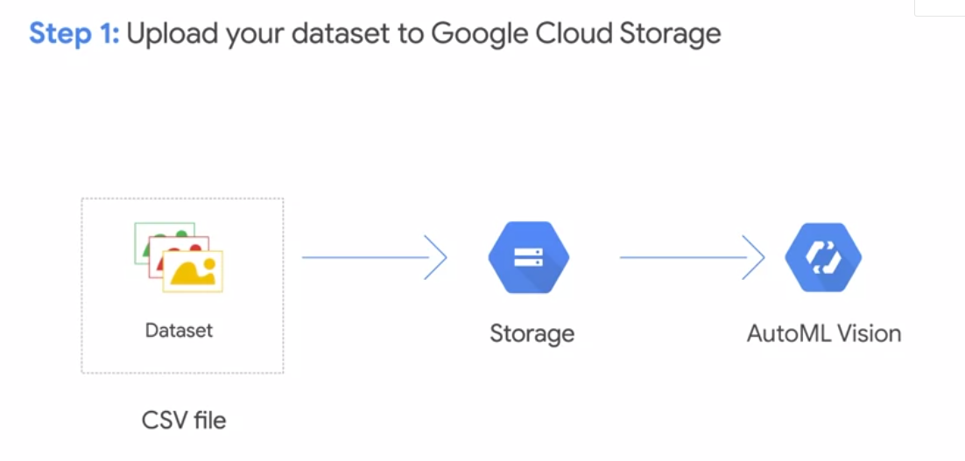
AutoML API
Notes:
Oke now lets see how easy it is to use the AutoML PAI
You take your csv and you upload it to the storage of google. This is a separate service which you pay monthly per gb
Then you go to the Vision API

Slide 43
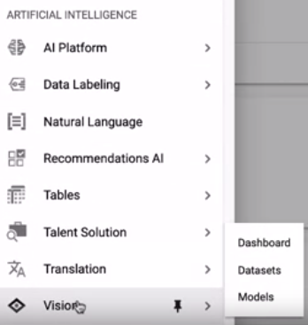
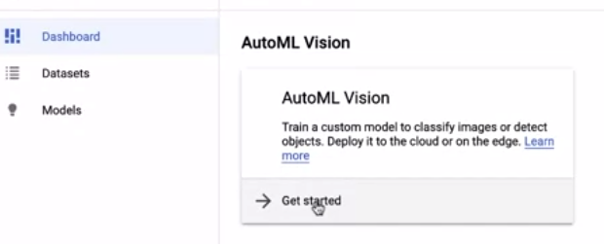
AutoML API
Choose the vision API
Click AutoML Vision
Notes:
You simply go to vision API and choose the AutoML vision

Slide 44
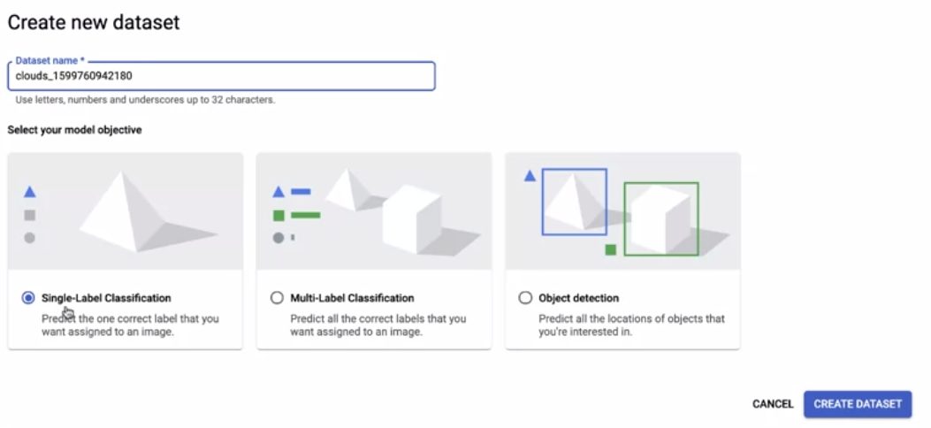
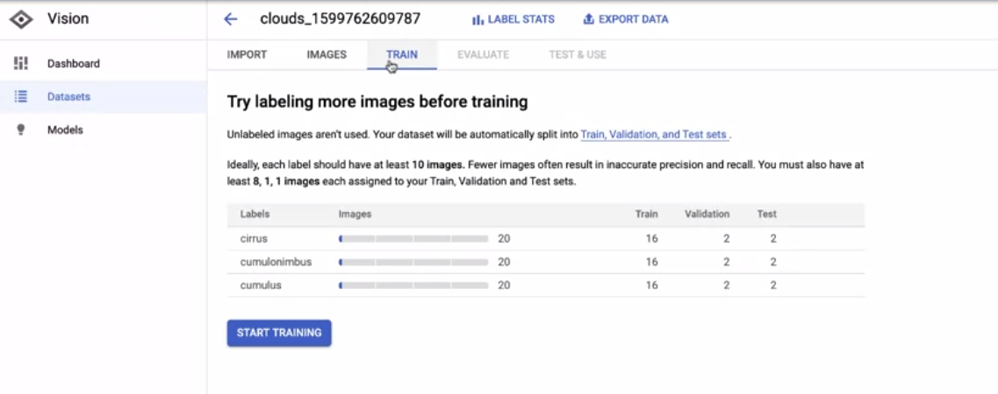
AutoML API
Create a dataset using your uploaded data
Click Train
Notes:
You crate a new instance of your upload dataset by picking the properties you want.
And then you simply click train!
AutoML takes cares of the rest!

Slide 45
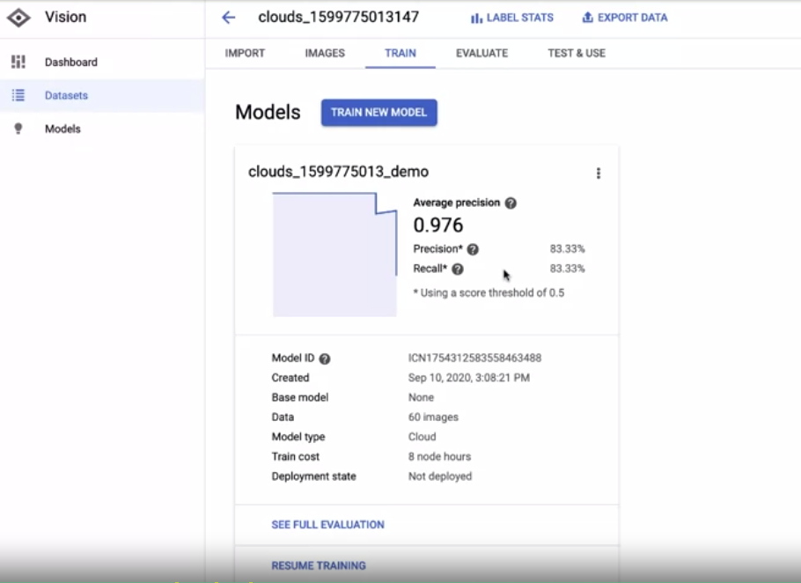
AutoML API
Check the Evaluation
Notes:
When the model is trained you can just its evaluation and decide if its allright or you want to furtherly improve it.

Slide 46
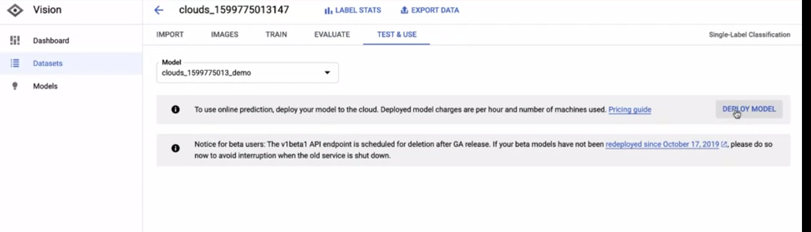
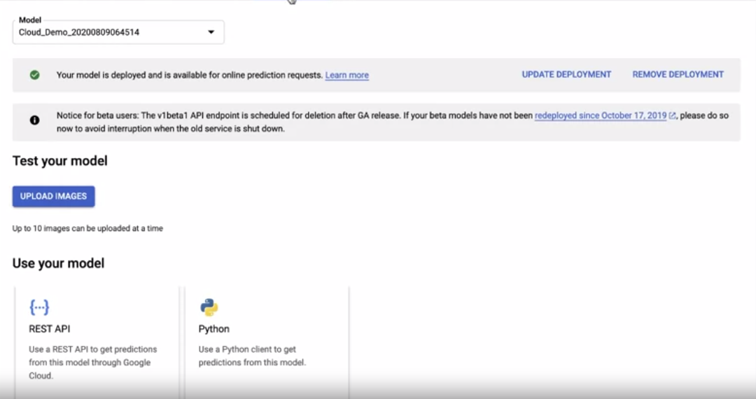
AutoML API
Deploy the model!!
Make new predictions!
Notes:
When the model is fine for you, you just click deploy!
And then you make new predictions or create an API call that will be wrapped up in another part of your application.
Its that simple to train and deploy a model.
Please before trying it! Pay clouse attention to billing services. You might be charged out of nowhere. I am serious about this

Slide 47
Train your own Model
Notes:
Ok good with AutoML and pre-trained models.
What if I want to train my own model?
Lets see how we can do this.

Slide 48
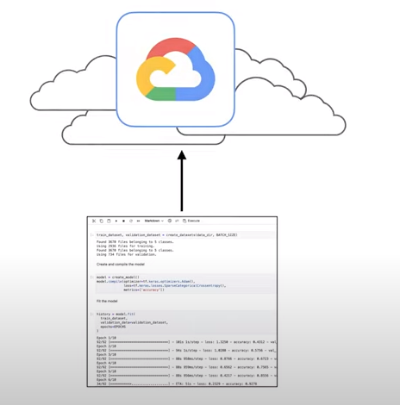
Deploy your Prototype
You have finished the Modelling Stage
You have done model selection and hyperparameter tuning
You want to take your model to production
Notes:
Say you have finished developing a prototype offline ina a jupyter notebook.
You are good with your evaluation and your ready to deploy it in cloud.

Slide 49
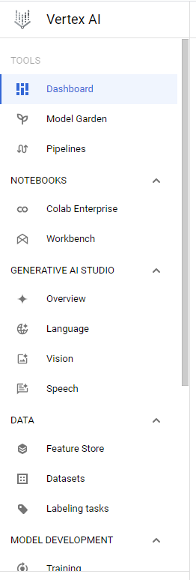
From Prototype to Production
Vertex AI is Google Cloud Machine Learning platform
Train and Deploy ML models
Design ML engineering workflows
Use AutoML or custom training processes
Evaluate & Monitor your models
Scales automatically
Notes:
Google has a service ready for you, Vertex AI.
It takes your model and your data, trains it and deploys it.
It allows the creation of the entire ml workflow.
You can also select if you want to choose AutoML or you want to apply a custom training process like the one on your prototype.
The biggest advantage though is that it scales automatically. That means you dont have to worry about how many users will interact with it.

Slide 50
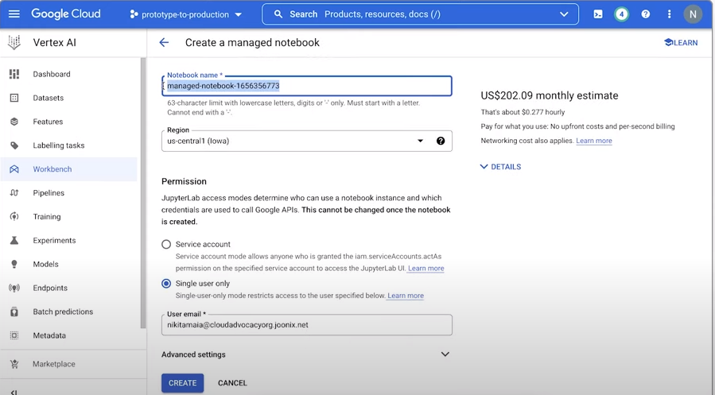
Work with Notebooks
You can easily create jupyter notebooks
Notes:
You can even work with Notebooks as you did when you were prototyping.
Vertex AI allows you to create a new notebook instance

Slide 51
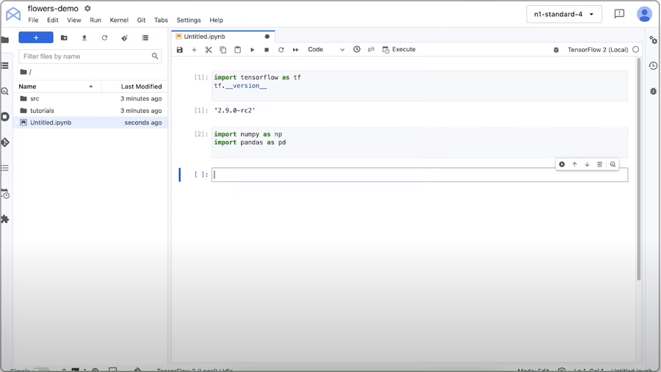
Work with Notebooks
Same as you would with your IDE
Notes:
And you work as you would do in your offline IDE

Slide 52
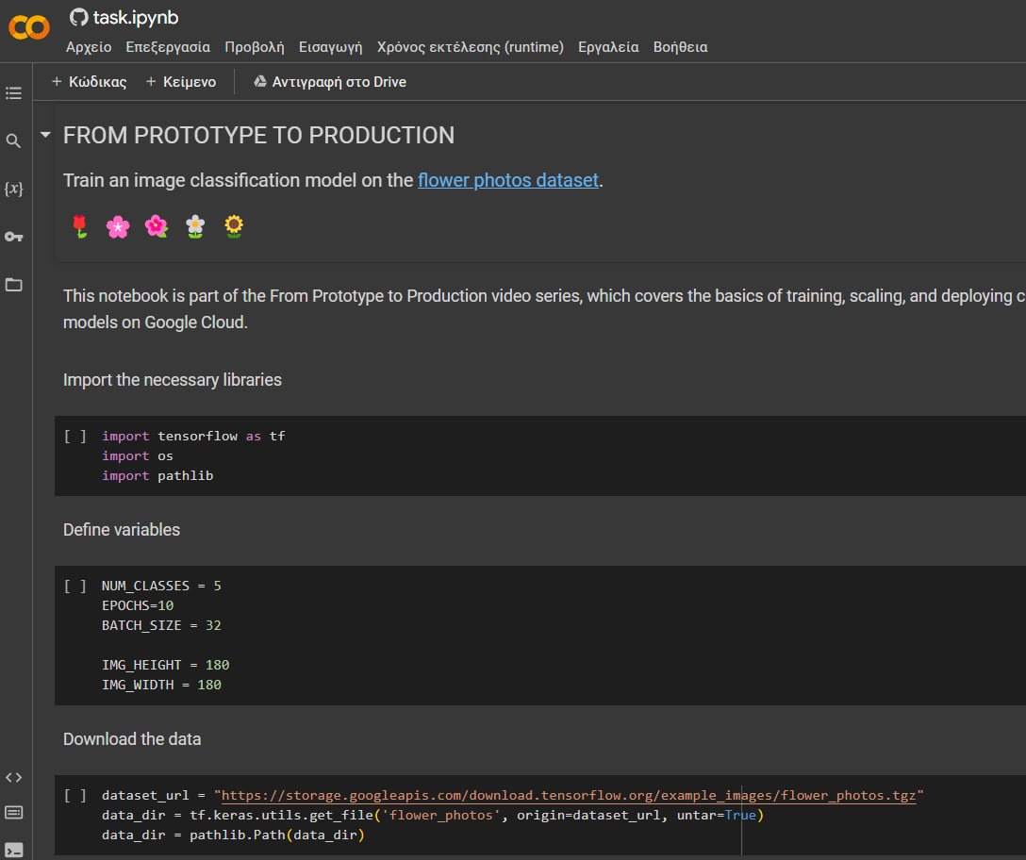
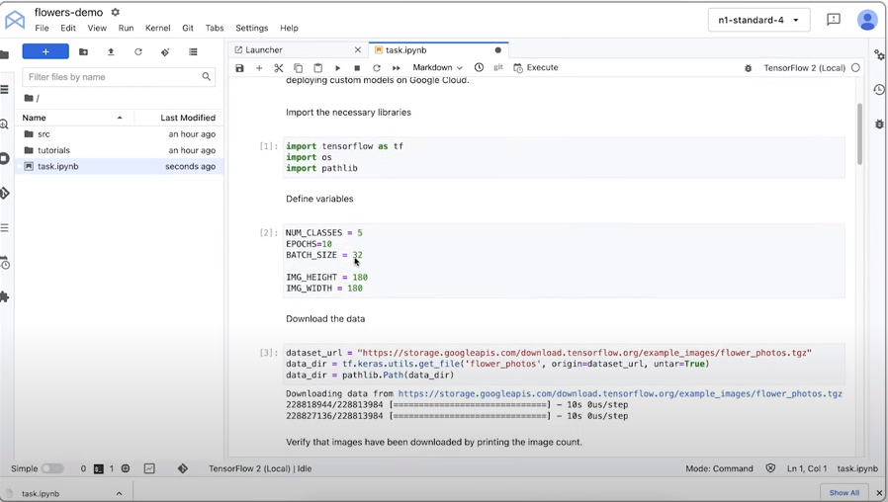
Notebook Example
Notes:
You can upload your colab notebook or write it from scratch.
The difference is that you set the path from google storage to load and save your data

Slide 53
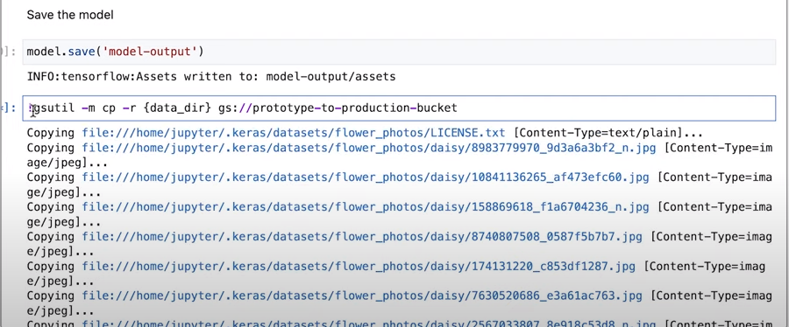
Notebook Example
After training you save the model to Google Storage
Notes:
When you finish training your model you dump the model to google storage so you can easily retrieve it later for improving it or for making predictions.
Again be careful with teh costs!! They can rise realy fast!

Slide 54
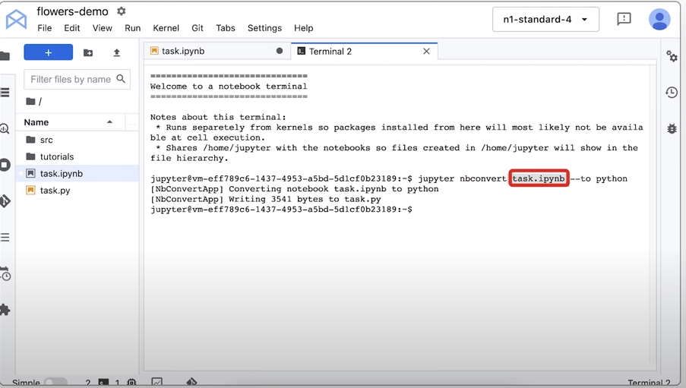
From Notebooks to Scripts
Remember:
In production we have scripts not notebooks!
We need to convert the .ipynb to .py
Either Manually
Or automatically
(using nbconvert on terminal)
Notes:
And if we want to work properly, as we said, in production we have .py scripts not notebooks.
So when we finished prototyping, we take our code and convert it into a .py script.
You can either do it manually or automaticaly using nbconvert.
I suggest you doing it manualy because in my experience nbconvert did not work so well.
Also we said its very important to structure your repo nicely. So dont have your full code in a single repo but split it accordingly.

Slide 55


Remember Docker?
After training we Dockerize our file by creating the Dockerfile!
Format of the Dockerfile
Notes:
And as we have said in the previous lecture. We always dockerize!!
We create a nice repo, we create the dockerfile. You cna find details for that on the docker course

Slide 56

Building the Image
Then we build an Image for the Dockerfile!
Notes:
And finaly you simply build the image by creating a terminal.
As you would in your Visual studio code

Slide 57

The Dockerized App
We can view our Dockerized training app on Artifacts Registry!
To access Artifacts registry just type on search
Notes:
When you dockerize your application an artifact is created on the artifacts registry with your model.
You can access it by doing a simple search
You will see a registry with the application with your model

Slide 58


Train from a Container
Start a new training instance from the main menu
Chose your custom container
Notes:
Ok good. We have dockerized our application, we have seen our artificat. Time to train.
From the VertexAI menu you go to training and you create a new training instance.
You pick the container (its important to contenairze your application)

Slide 59

Train from a Container
Monitor training!
Notes:
And you start training your model. The menu is actually very simple and you can easily use it to train any models.

Slide 60

Make Predictions: Importing
We first want to import our trained model
Notes:
And once we finished training, we go to the models tab and we want to import our pretrained model.

Slide 61

Make Predictions: Importing
We choose a Default Framework and browse to our model artifact location.
You can find its location using the Artifacts registry
Notes:
You choose a framework (Say tensorflow or anything but tensorflow works most of the time) and you go and find the artifact of your pretrained model.
VertexAI will automatically create a new container for your trained model

Slide 62

Make Predictions: Deploying
After importing, we want to deploy the model to an endpoint (Create an API)
Notes:
And when you import you want to deploy in order to create an endpoint to use for your predictions.
You go deploy to endpoint

Slide 63

Make Predictions: Deploying
Specify some settings:
Name
Resources to use
Possible scaling
(More complex settings)
Notes:
You then specify some settings. Pretty straightforward
You add the name, what resources you want to use (scale automatically or not), if you want to forbit access to users, how you monitor and stuff like that.
Everything is ready for you with just a few clicks

Slide 64

Make Predictions: Deploy
After waiting some time the model is deployed on Vertex AI
Notes:
When you specify everything you wait for the model to be deployed and voila!
Its ready to be used

Slide 65
Make Predictions from the Endpoint
Take the ID of the endpoint with the model
Notes:
Next we take the ID of the enpdoint from your trained model

Slide 66

Make Predictions from the Endpoint
Specify the endpoint on a new script
Notes:
You go to your repo (or a new one)
create a new py script and add the ID of your endpoint
Then

Slide 67

Make Predictions from the Endpoint
Run your predictions as you would with any model
Notes:
And then you simply get your predictions!
You can then dockerize the predictions phase and wrap it into another application for mobile or browser or whatever!
Thats how you take a model and put it in hte cloud in case some of you will ever try it.

Slide 68
Extra Features
We know the ML workflow is not that easy!
Google Cloud offers the following:
Automatic hyperparameter tuning on the training phase
Distributed training for multiple workers
Scaling GPUs
Monitor the experiment
Create a ML lineage
Notes:
There are some extra features here that are provided by Google cloud for handling some of the concepts that might pop during deploying your model.
(read them)
Please pay a lot of attention to your billings if you try it. Take your time to understand everything before jumping into deploying a model to production!

